Slide 1
University of Missouri System
Board of Curators
September 2, 2021
Audit, Compliance and Ethics Committee
Audit, Compliance and Ethics Committee
Quarterly Report
UM

Slide 2
Summary of Internal Audit Activity
Finalizing one internal audit report
Three internal audits in process; one engagement to develop grant monitoring in process
Twenty-two audits/consulting projects not started
Actively working one investigation

Slide 3
Status of Management Action Plans As of June 30, 2021
Twelve action plan items in four audits were reviewed for completion as of June 30, 2021.
Four of twelve, or 33 percent were completed.
Seven action plans in two audits were assigned extended due dates.
One action item was placed on hold due to a potential technology system change.

Slide 4
Establishing the Compliance Program Progress Update
Executive order to establish authority of the compliance program is under leadership review
Draft system Audit and Compliance Committee Charter under leadership review
Code of Conduct on target for introduction and rollout beginning in October
Training and rollout plans under development

Slide 5
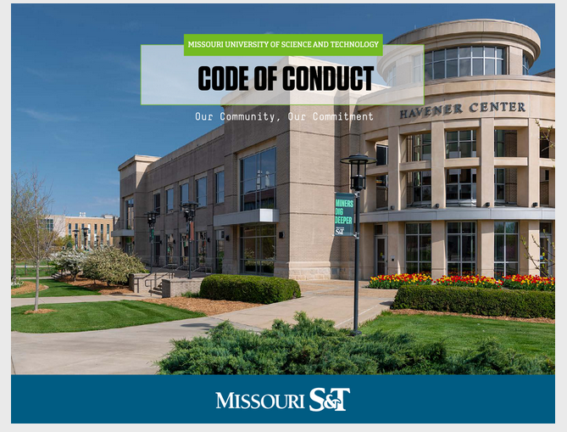
Design Unique to each University

Slide 6
Questions?

